Slide 1
Topic 5: Preprocessor

Slide 2
Preprocessor
Ask the compiler to perform some works in advance
Common preprocessor
#define
#include
#ifdef #ifndef #if #else #elif #endif
The usage
#ifdef DEBUG_INFO
printf(“debug: %d \n”, x);
#endif
Notes:
pound sign

Slide 3
Preprocessor
#ifdef (DEBUG_INFO) equals to #if defined (DEBUG_INFO)
The usage of #if defined is more complicated
Example
#if !defined DEBUG_INFO
(If not defining DEBUG_INFO, the process goes)
#if defined DEBUG_INFO || !defined VERBOSE_INFO
(Both two condition should satisfy)
#if 0 (mark a whole segment)
#if VERBOSE_INFO > 2
#if chip == INTEL
Define the compile flag during compiler time → gcc –DDEBUG_INFO

Slide 4
#include <stdio.h>
int main(void)
{
#ifdef Linux
printf("LINUX\n");
#elif defined (Windows)
printf("Microsoft Windows\n");
#elif defined(OS)
printf("OS=%s", OS);
#else
printf("Unknown\n");
#endif
}
> gcc define.c
> ./a.out
Unknown
> gcc -DWindows define.c
> ./a.out
Microsoft Windows
> gcc -DOS=\"Sun\" define.c
> ./a.out
OS=Sun

Slide 5
Preprocessor
In a large-scale C project, the header file .h contains
#ifndef _GLOBE_H
#define _GLOBE_H
typedef …
… …
… …
#endif /*GLOBE_H*/
Assume that both a1.c and a2.c include this header file. When a1.c was compiled earlier, this preprocessor can avoid duplicate declaration.

Slide 6
Preprocessor
If you find multiple definition of xxxxx when building your project
Check if you add the #ifndef …..
Check the compilation unit
Two object file .o include common objects
→ solution: (1) Use the extern keyword in the header .h file
(2) Declare the main body in a C file
https://www.unix.com/programming/219335-c-program-multiple-definition-error-during-linking-time.html
The new GCC (at least mine) seems to handle this kind of simple error directly

Slide 7
#pragma
The keywords for compiler → configure the compiler for cross platform
Example
#pragma asm: The following parts are assembly language (Microsoft C)
#pragma small: Small memory mode (Microsoft C)
#pragma code: Put read only data in ROM to save RAM (Keil C)
Can be use as message
#ifdef _X86 #pragma message(“_X86 macro activated!”) #endif
Reference: http://topalan.pixnet.net/blog/post/22334686

Slide 8
inline (can taken as macro)
Ask the compiler to set a function as an “inline function”
Ex:
inline void set_bit (Int8 *target, Int8 bit)
{ ……
}
If the compiler accepts your demand, the above function can be taken as
#define set_bit xxxx

Slide 9
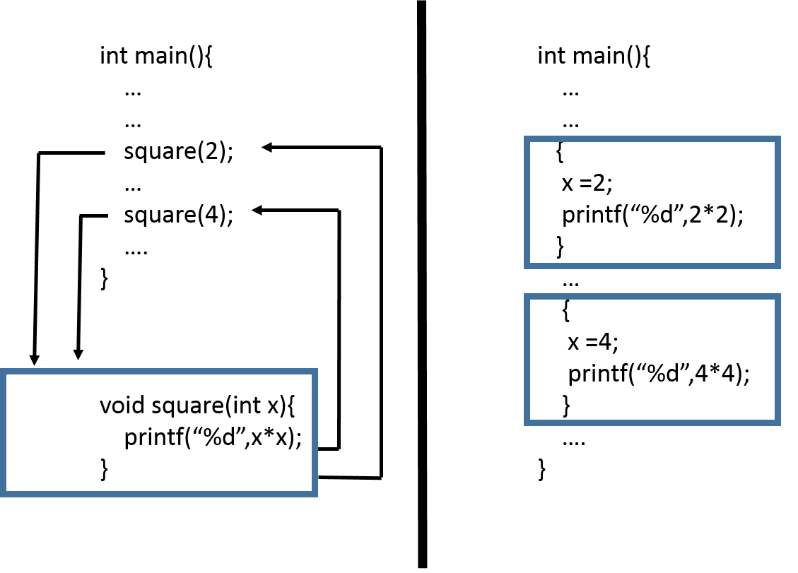
General procedure
Inline function

Slide 10
Special compiler keywords
#include <stdio.h>
#pragma message(“Compiling”) //not support in new gcc version
int main(void)
{
printf("Compiling %s, line: %d, on %s, at %s, STDC=%d \n",
__FILE__, __LINE__, __DATE__, __TIME__, __STDC__);
//__STDC__ : check if ANSI C
return 0;
}
#if __STDC__
extern int a1(int);
#else
extern int a1(void);
#endif

Slide 11
Makefile
CC = gcc
OBJ = main.o change.o
EXE = run
all: $(EXE)
.c.o: ; $(CC) -c $*.c
$(EXE): $(OBJ)
$(CC) -o $@ $(OBJ)
clean:
rm -rf $(EXE) *.o *.d core
build all .c files to be .o files
$@ means include the parameter $(EXE)
You should use “TAB” to indent
Notes:
http://maxubuntu.blogspot.com/2010/02/makefile.html

Slide 12
W9-on site assignment
Divide your assignment last week to be five files main.c, ui.c, ui.h, list.c, list.h, you should have your own makefile
ui.c → include those functions about user interface
list.c → includes list operations

Slide 13
main.c

Slide 14
ui.h

Slide 15
list.h

